Slide 1
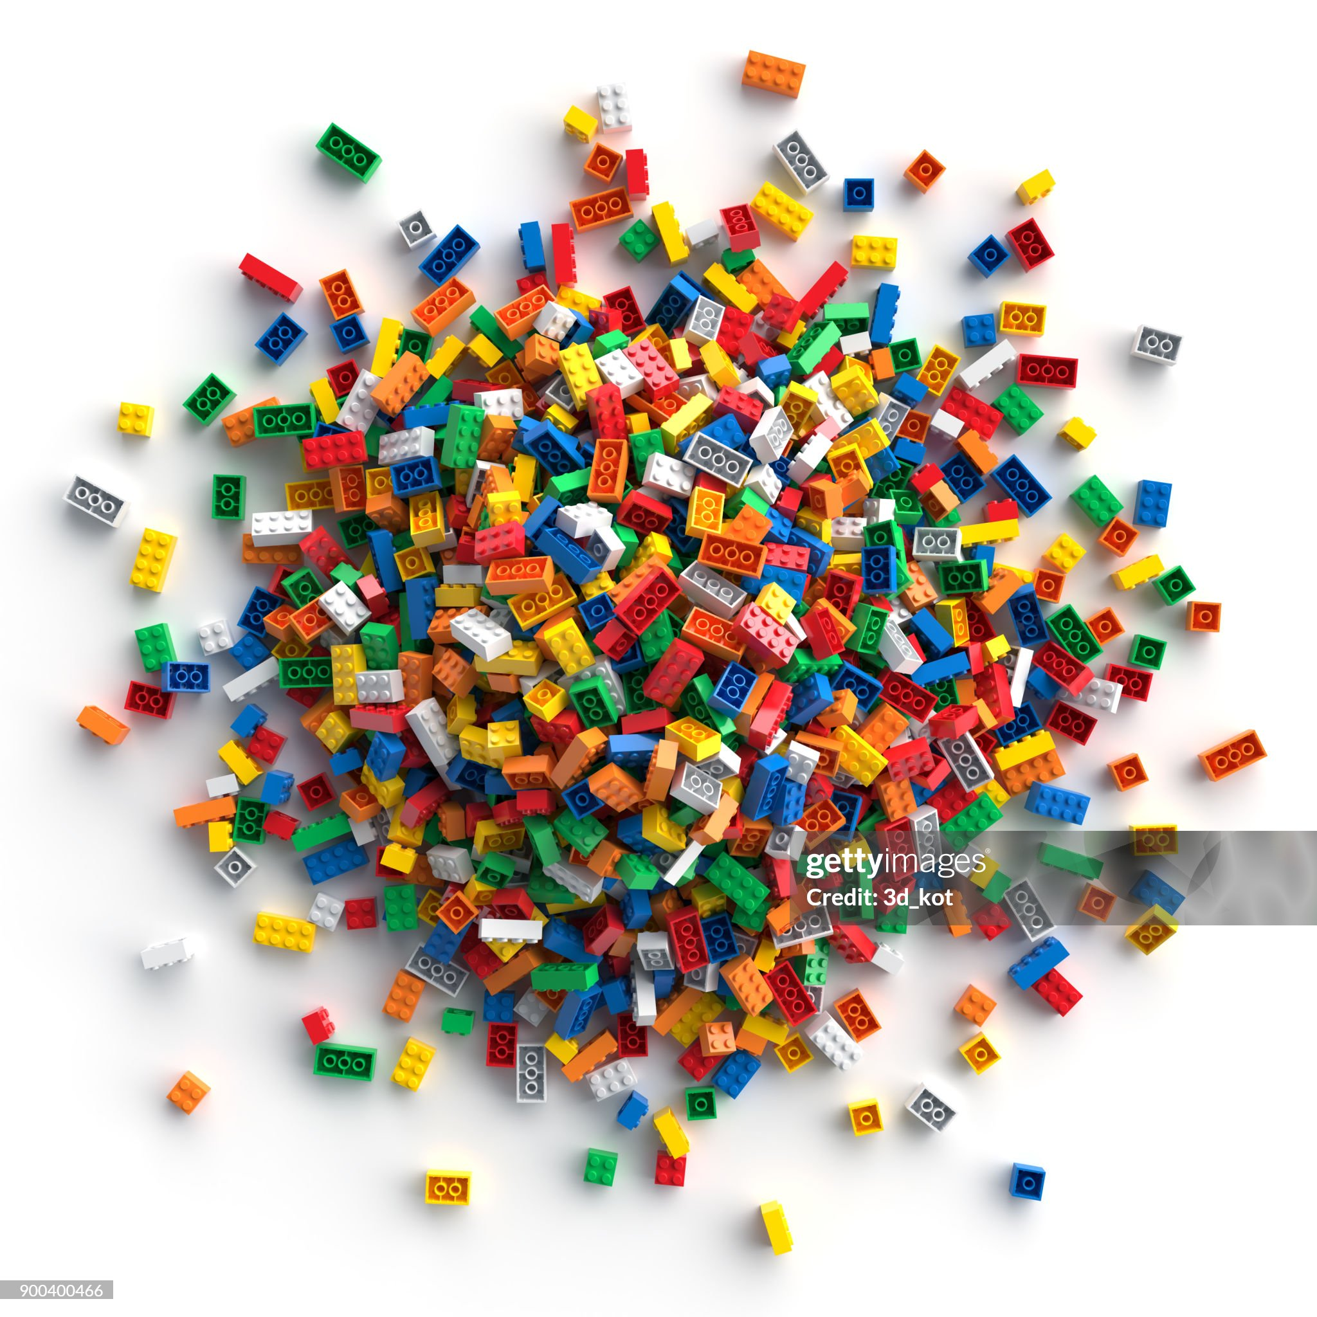
Massive innovation, expensive duplication, no standardization
The price of unbridled exploration
So many options, how do decide?
Constantly reinventing the wheel
Few best practices, wasted dev cycles.
Multiple, circuitous routes to the same place
Can we be pioneers without so much chaos?
Notes:
K: And what happens when we get excited and push technology boundaries?
E: As much fun as we’re having making cool new stuff, we tend to focus on the end goal and getting there by any means necessary. That can mean we are constantly reinventing the wheel, which is not the open source way, as we all know.
K: We are breaking a lot of new ground quickly, and there are a lot of different options and paths to reach the same goal. When we are pioneers in a new technology, we often don’t have the luxury of referencing the best practices of those who have gone before us.
E: Because we have so many options, we may end up like this disorganized pile of legos here without a reproduceable way of working.
K: As a community, I think we can do better, and benefit from what we’re all learning in our silos, and bring it together to forge a more standardized path

Slide 2
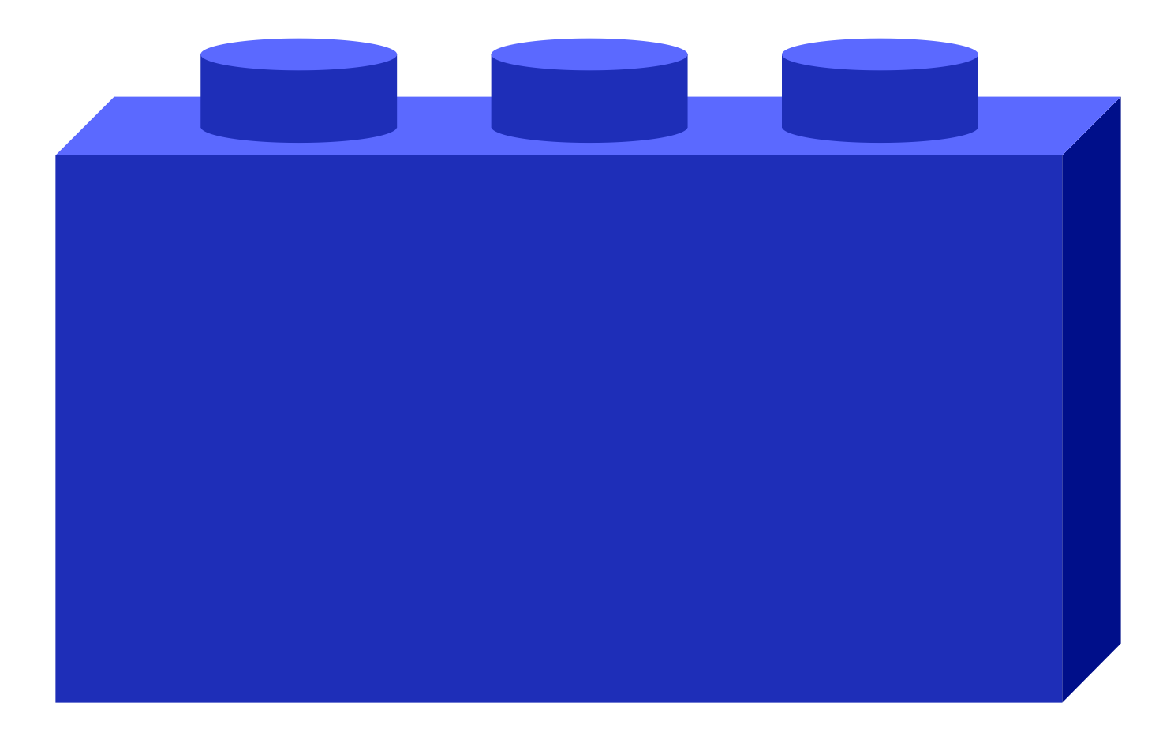


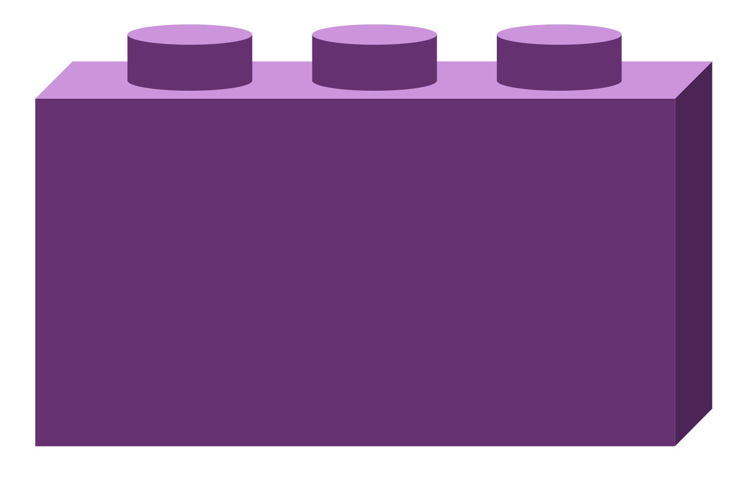

Life is easier when things go together
NEW
Why standardization matters
Notes:
K: When We’re focused on rapid innovation, especially in pioneering fields, we may be focused on a goal, on a minimum viable product, getting some functionality out the door. But what is sometimes lost in that drive is the foresight to apply principles that lead to interoperability and flexibility.
And in emerging fields where best practices and modular architectures have not yet been established, that lack of established best practices and standardization slows down developement processes. AI development is like the wild west, with everyone reinventing the wheel in silos. So what we’d like to see is adoption of community-established standards to smooth and speed up everyone’s development workflows.
I think we’re all open source people here. This is the open source way. We come together to establish the best way, and the vendor-neutral way.
So Eze, Generative AI development isn’t exactly new per se. How did we get here?

Slide 3
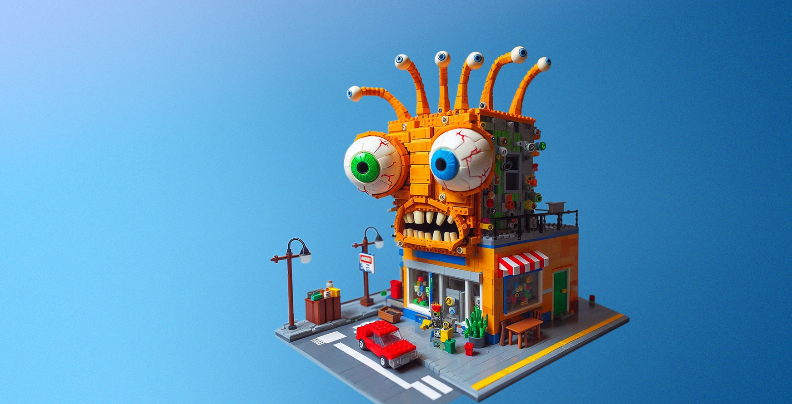
Gen AI RAG Application
Audacious development can be unwieldy
NEW
Notes:
E: This our current minimum viable product. It works, maybe even well, but you might be wondering how you can make any modifications to that
K: If we had started with something a little more orderly, we may not have created a monster.
We’ve all been there. It works, it was fun to build, but maybe it has a mind of its own!

Slide 4


Open-source platform that organizes GEN AI chaos
NEW Placement
Composable building blocks for generative AI systems
Integrates LLMs, data stores, and prompt engines RAG AI blueprint with component stack structure and end-to-end workflow
Additional stacks for translation, code generation, images
Generative AI assessment tool for performance, features, trustworthiness and enterprise-grade readiness
Notes:
E: Introduce OPEA (drop is your existing notes here)

Slide 5
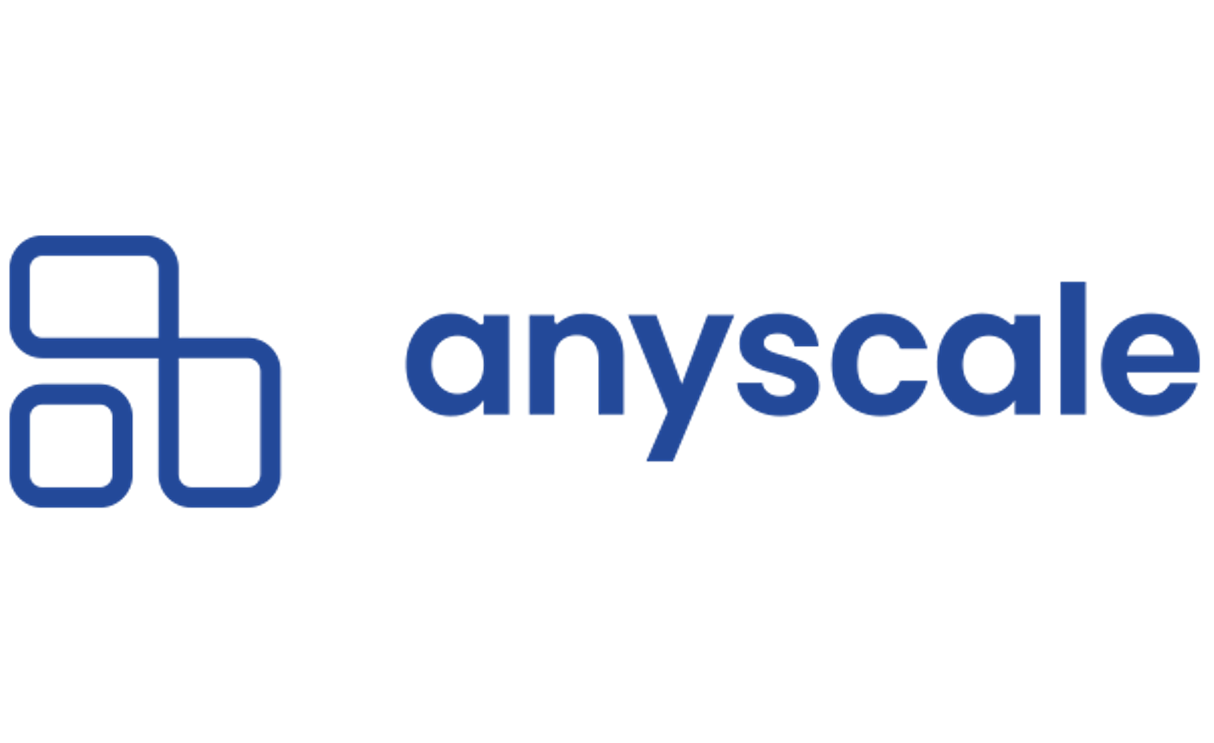









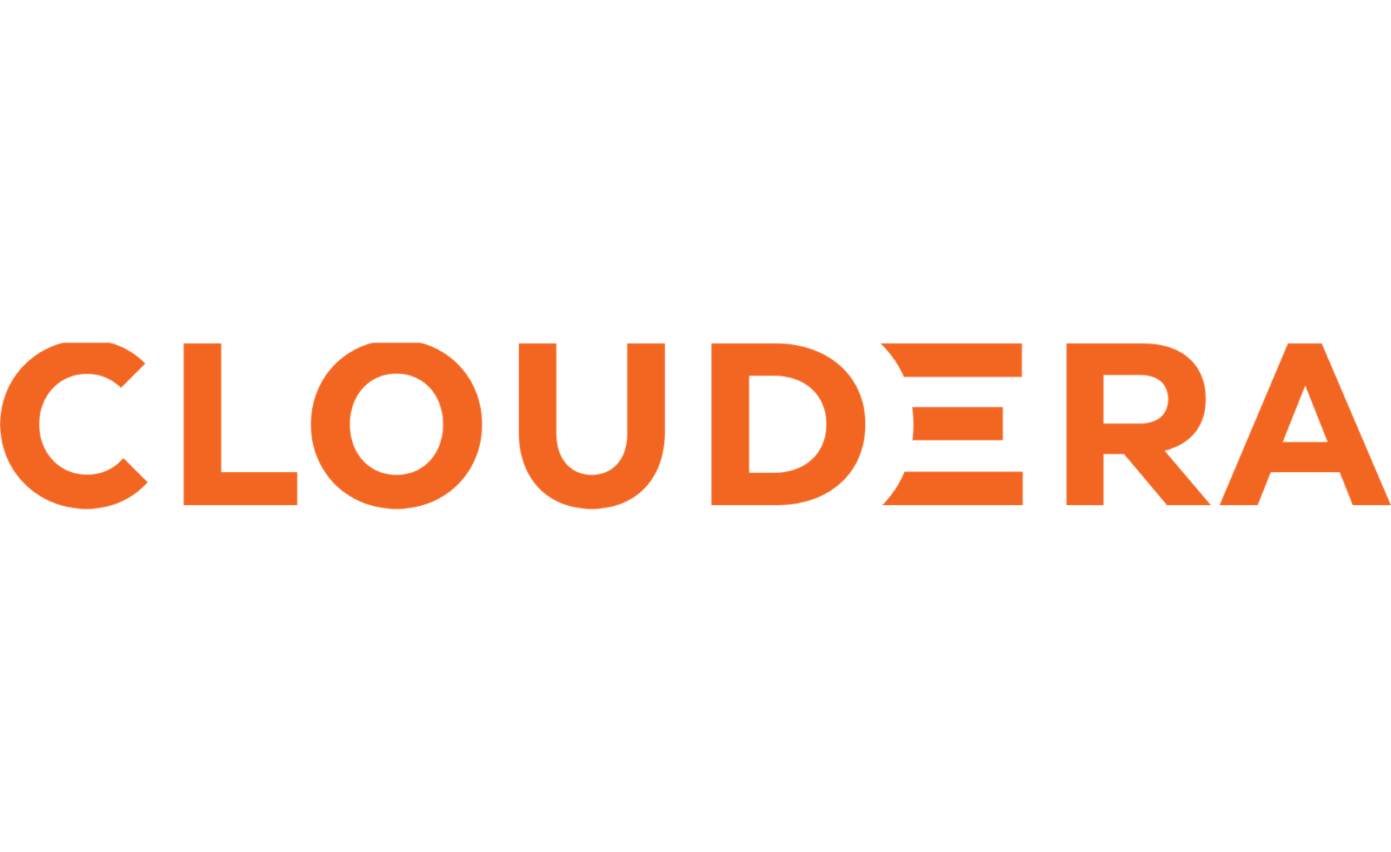







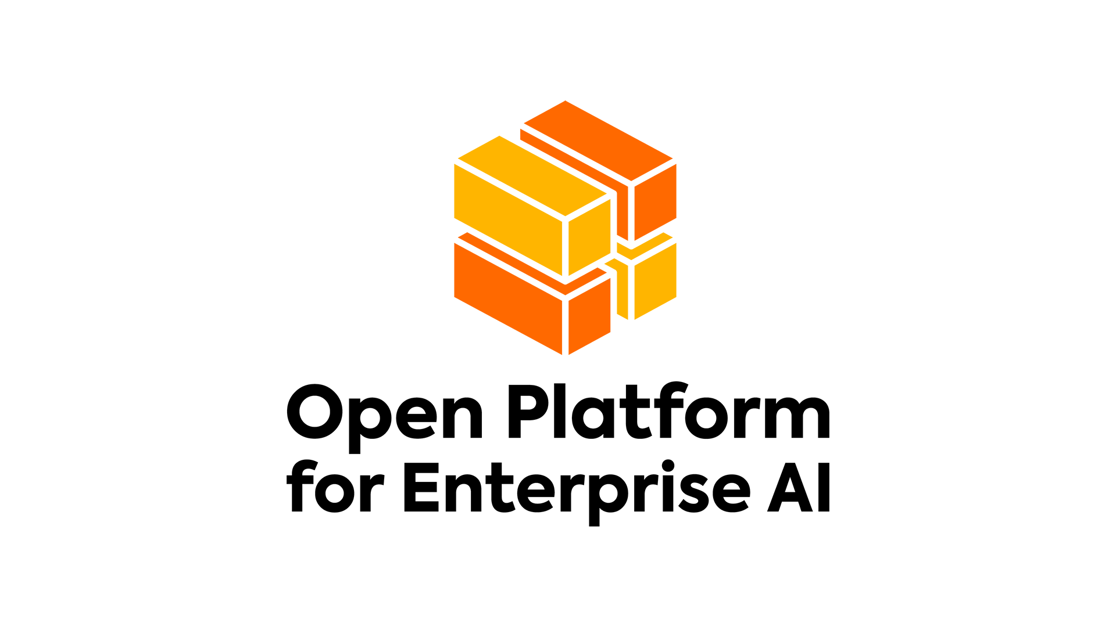











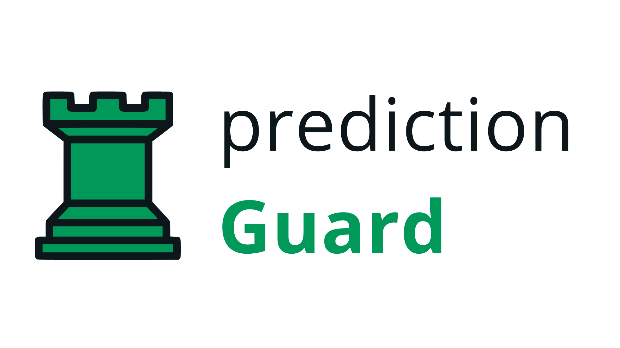
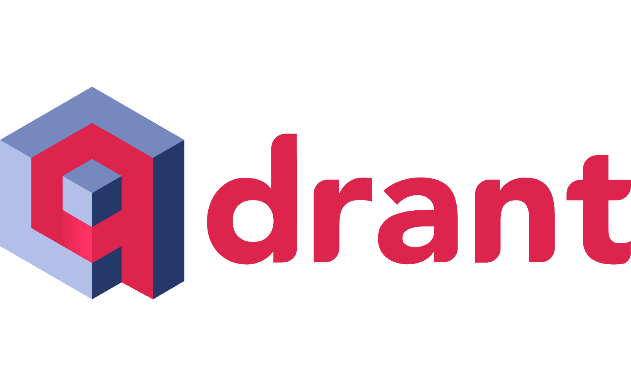





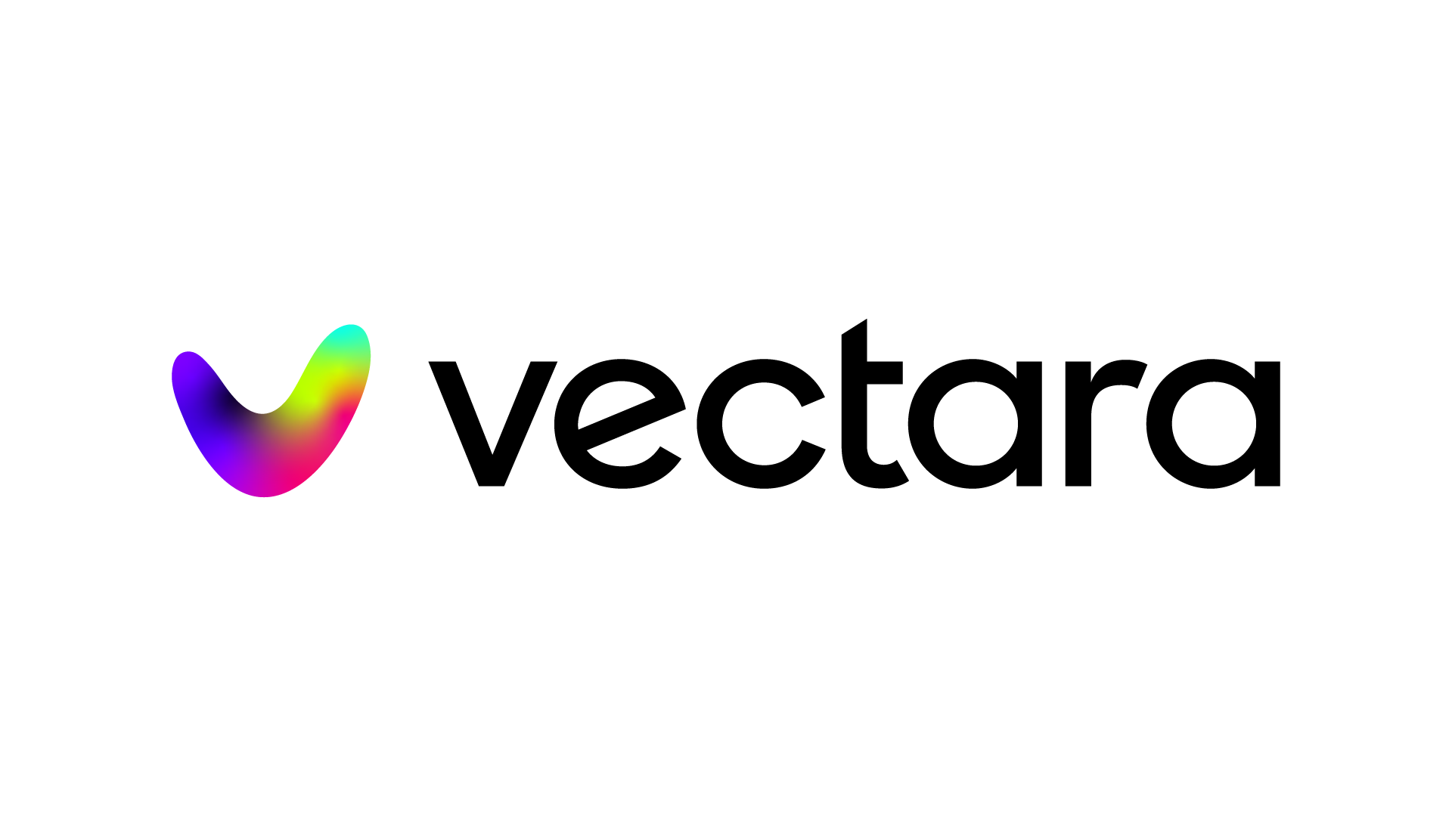



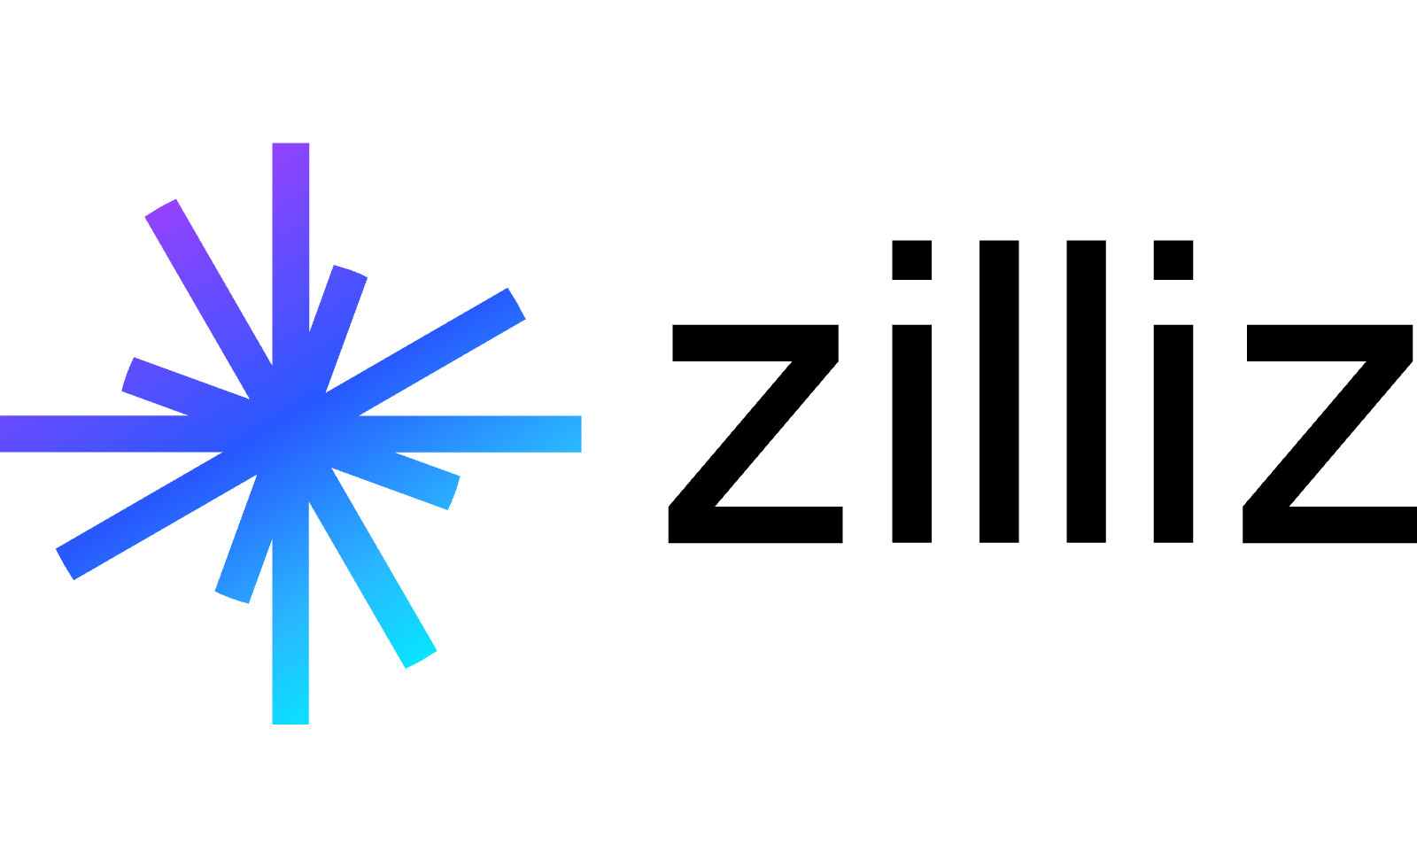

OPEA Contributors
NEW Placement
Notes:
K: We are from Intel, but this is not just an Intel effort. All of these lovely folks have joined us to collaborate on this platform to ensure interoperability, best practices and extensibility

Slide 6
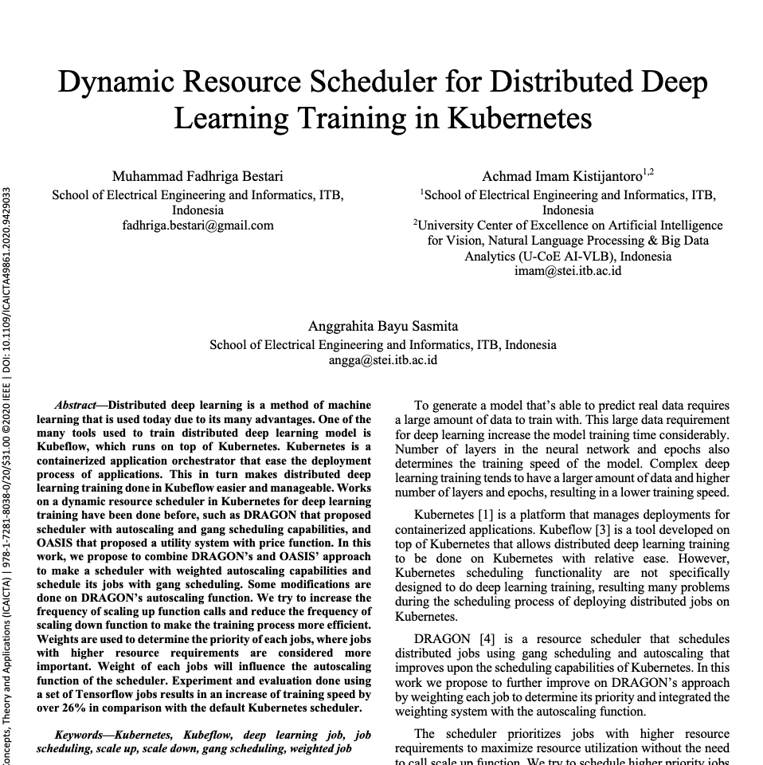
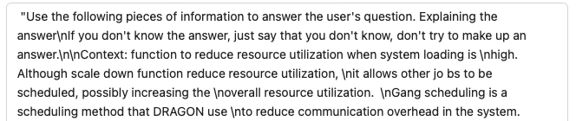
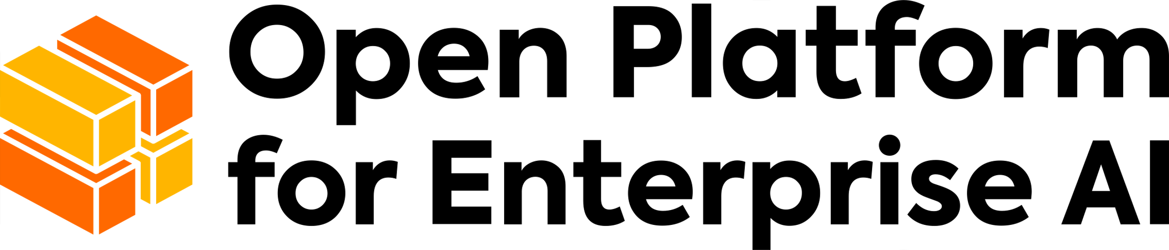
How OPEA RAG ChatQnA blueprint
Additional context
Instructions • Context • Prompt
Data Prep microservice
Embeddings microservice
VectorDB microservice
Question
Embeddings microservice
Retriever microservice
Reranking microservice
LLM microservice
Answer
🧠
Retrieval
✨
Augmentation
🤩
Generation

Slide 7
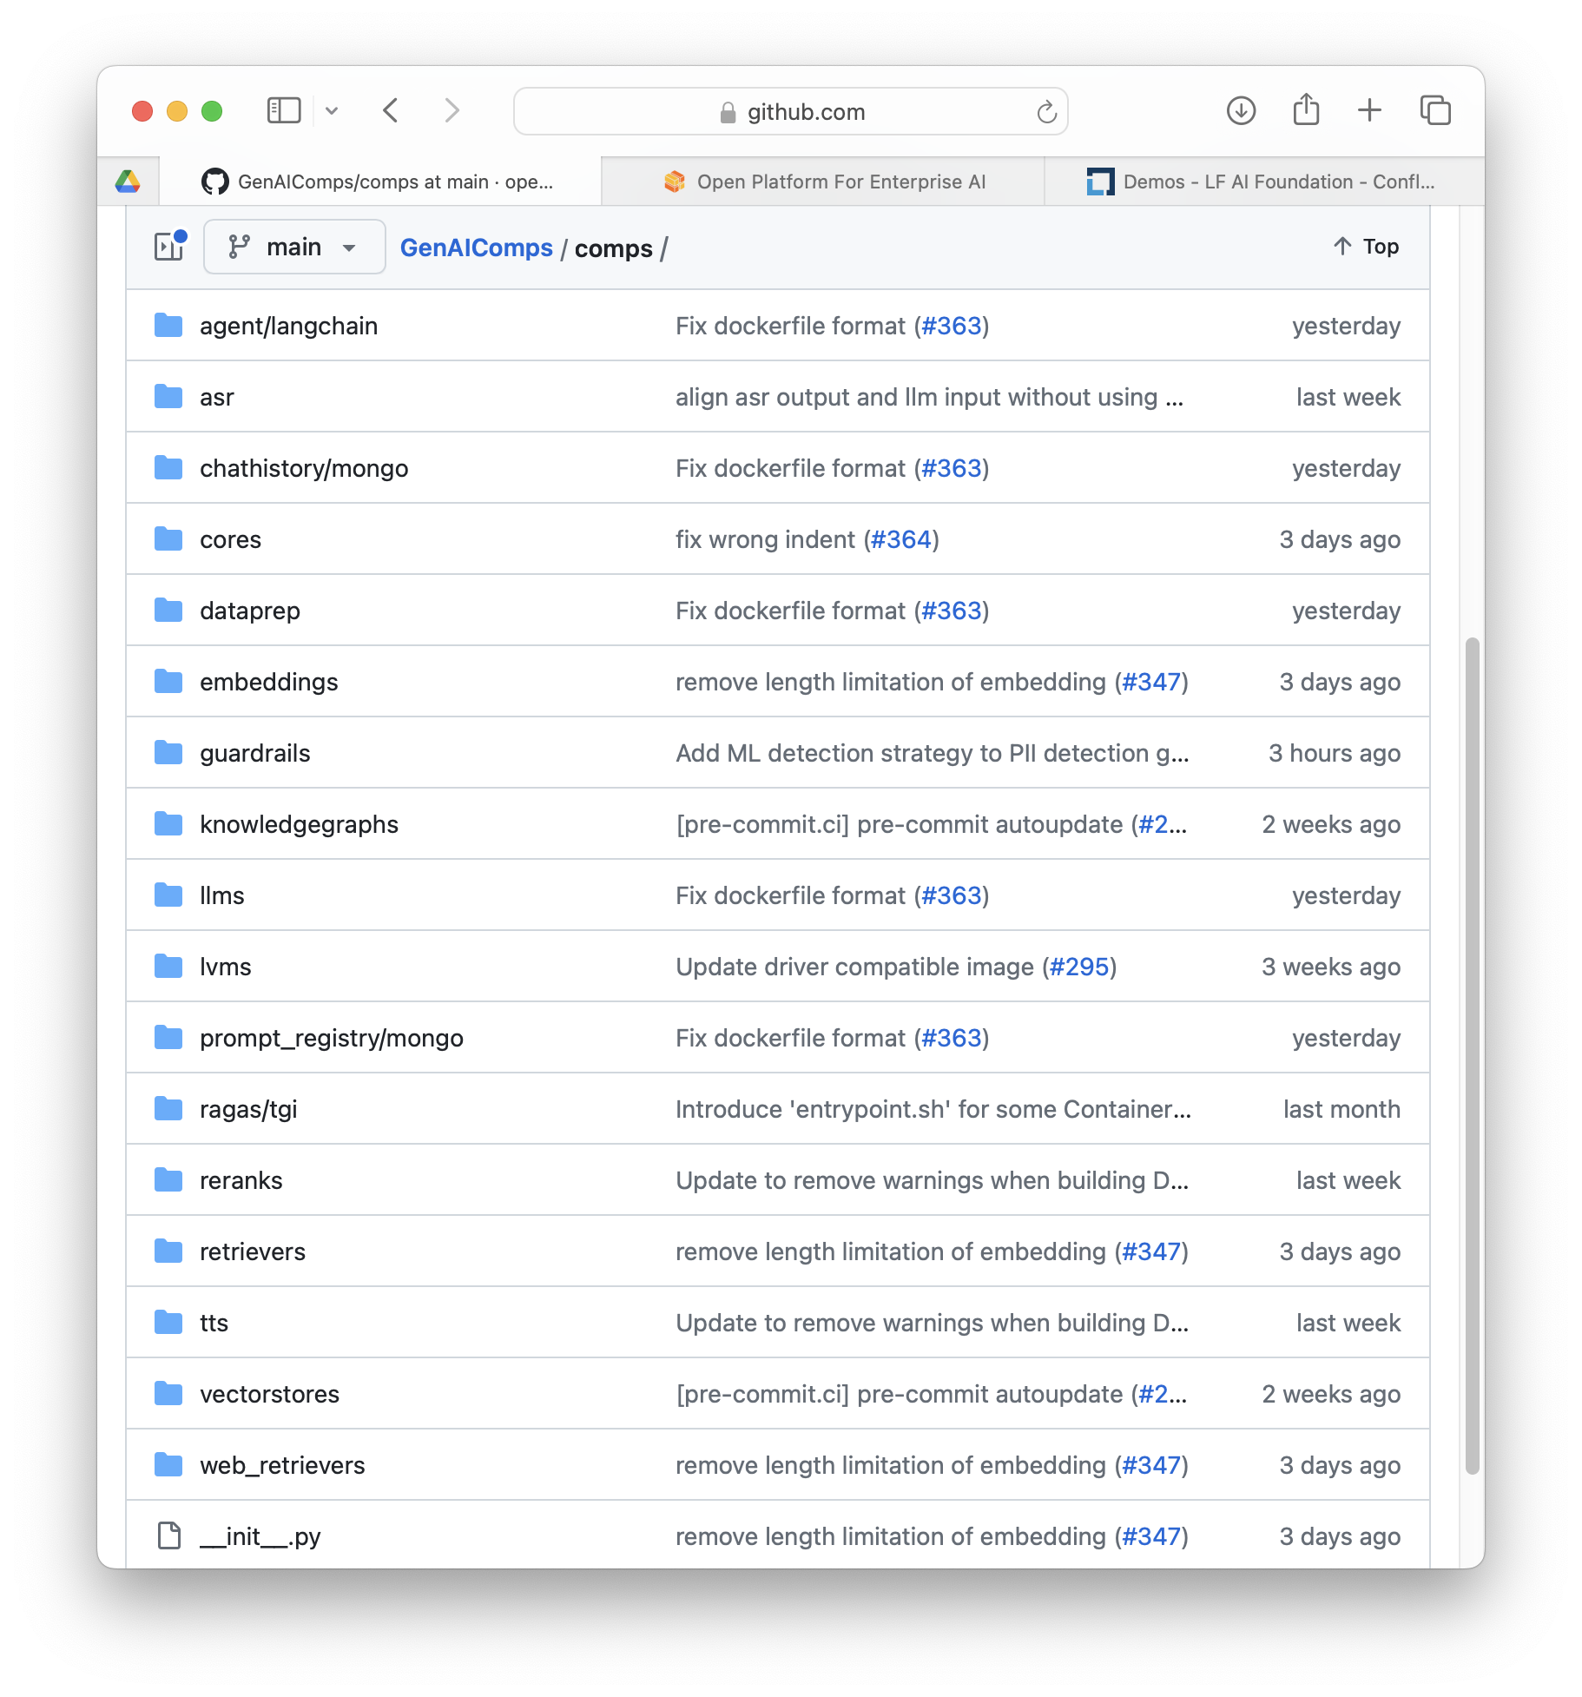
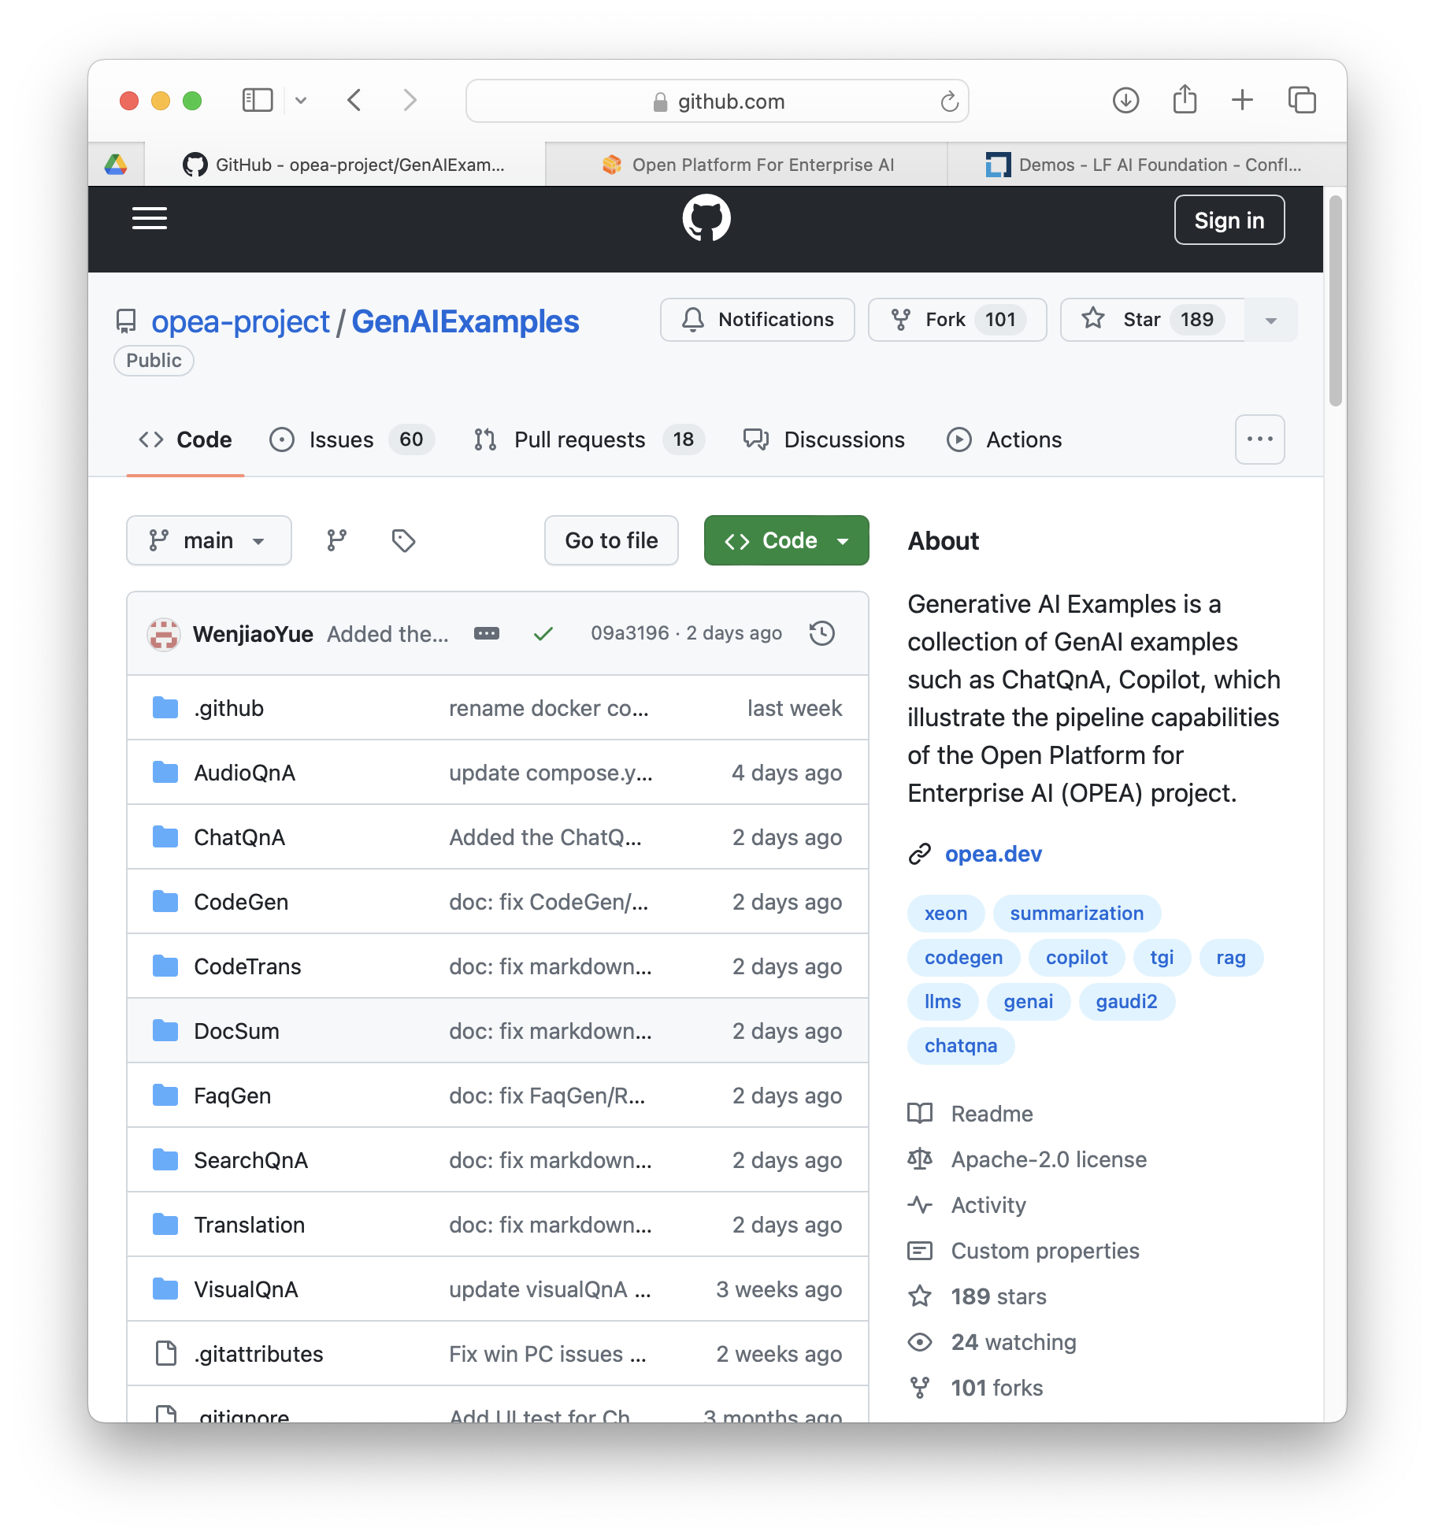
OPEA current components and applications
NEW Placement
Components
Example apps
Supporting apps
GenAI evaluator
GenAI inference
Governance
Back up for a demo

Slide 8
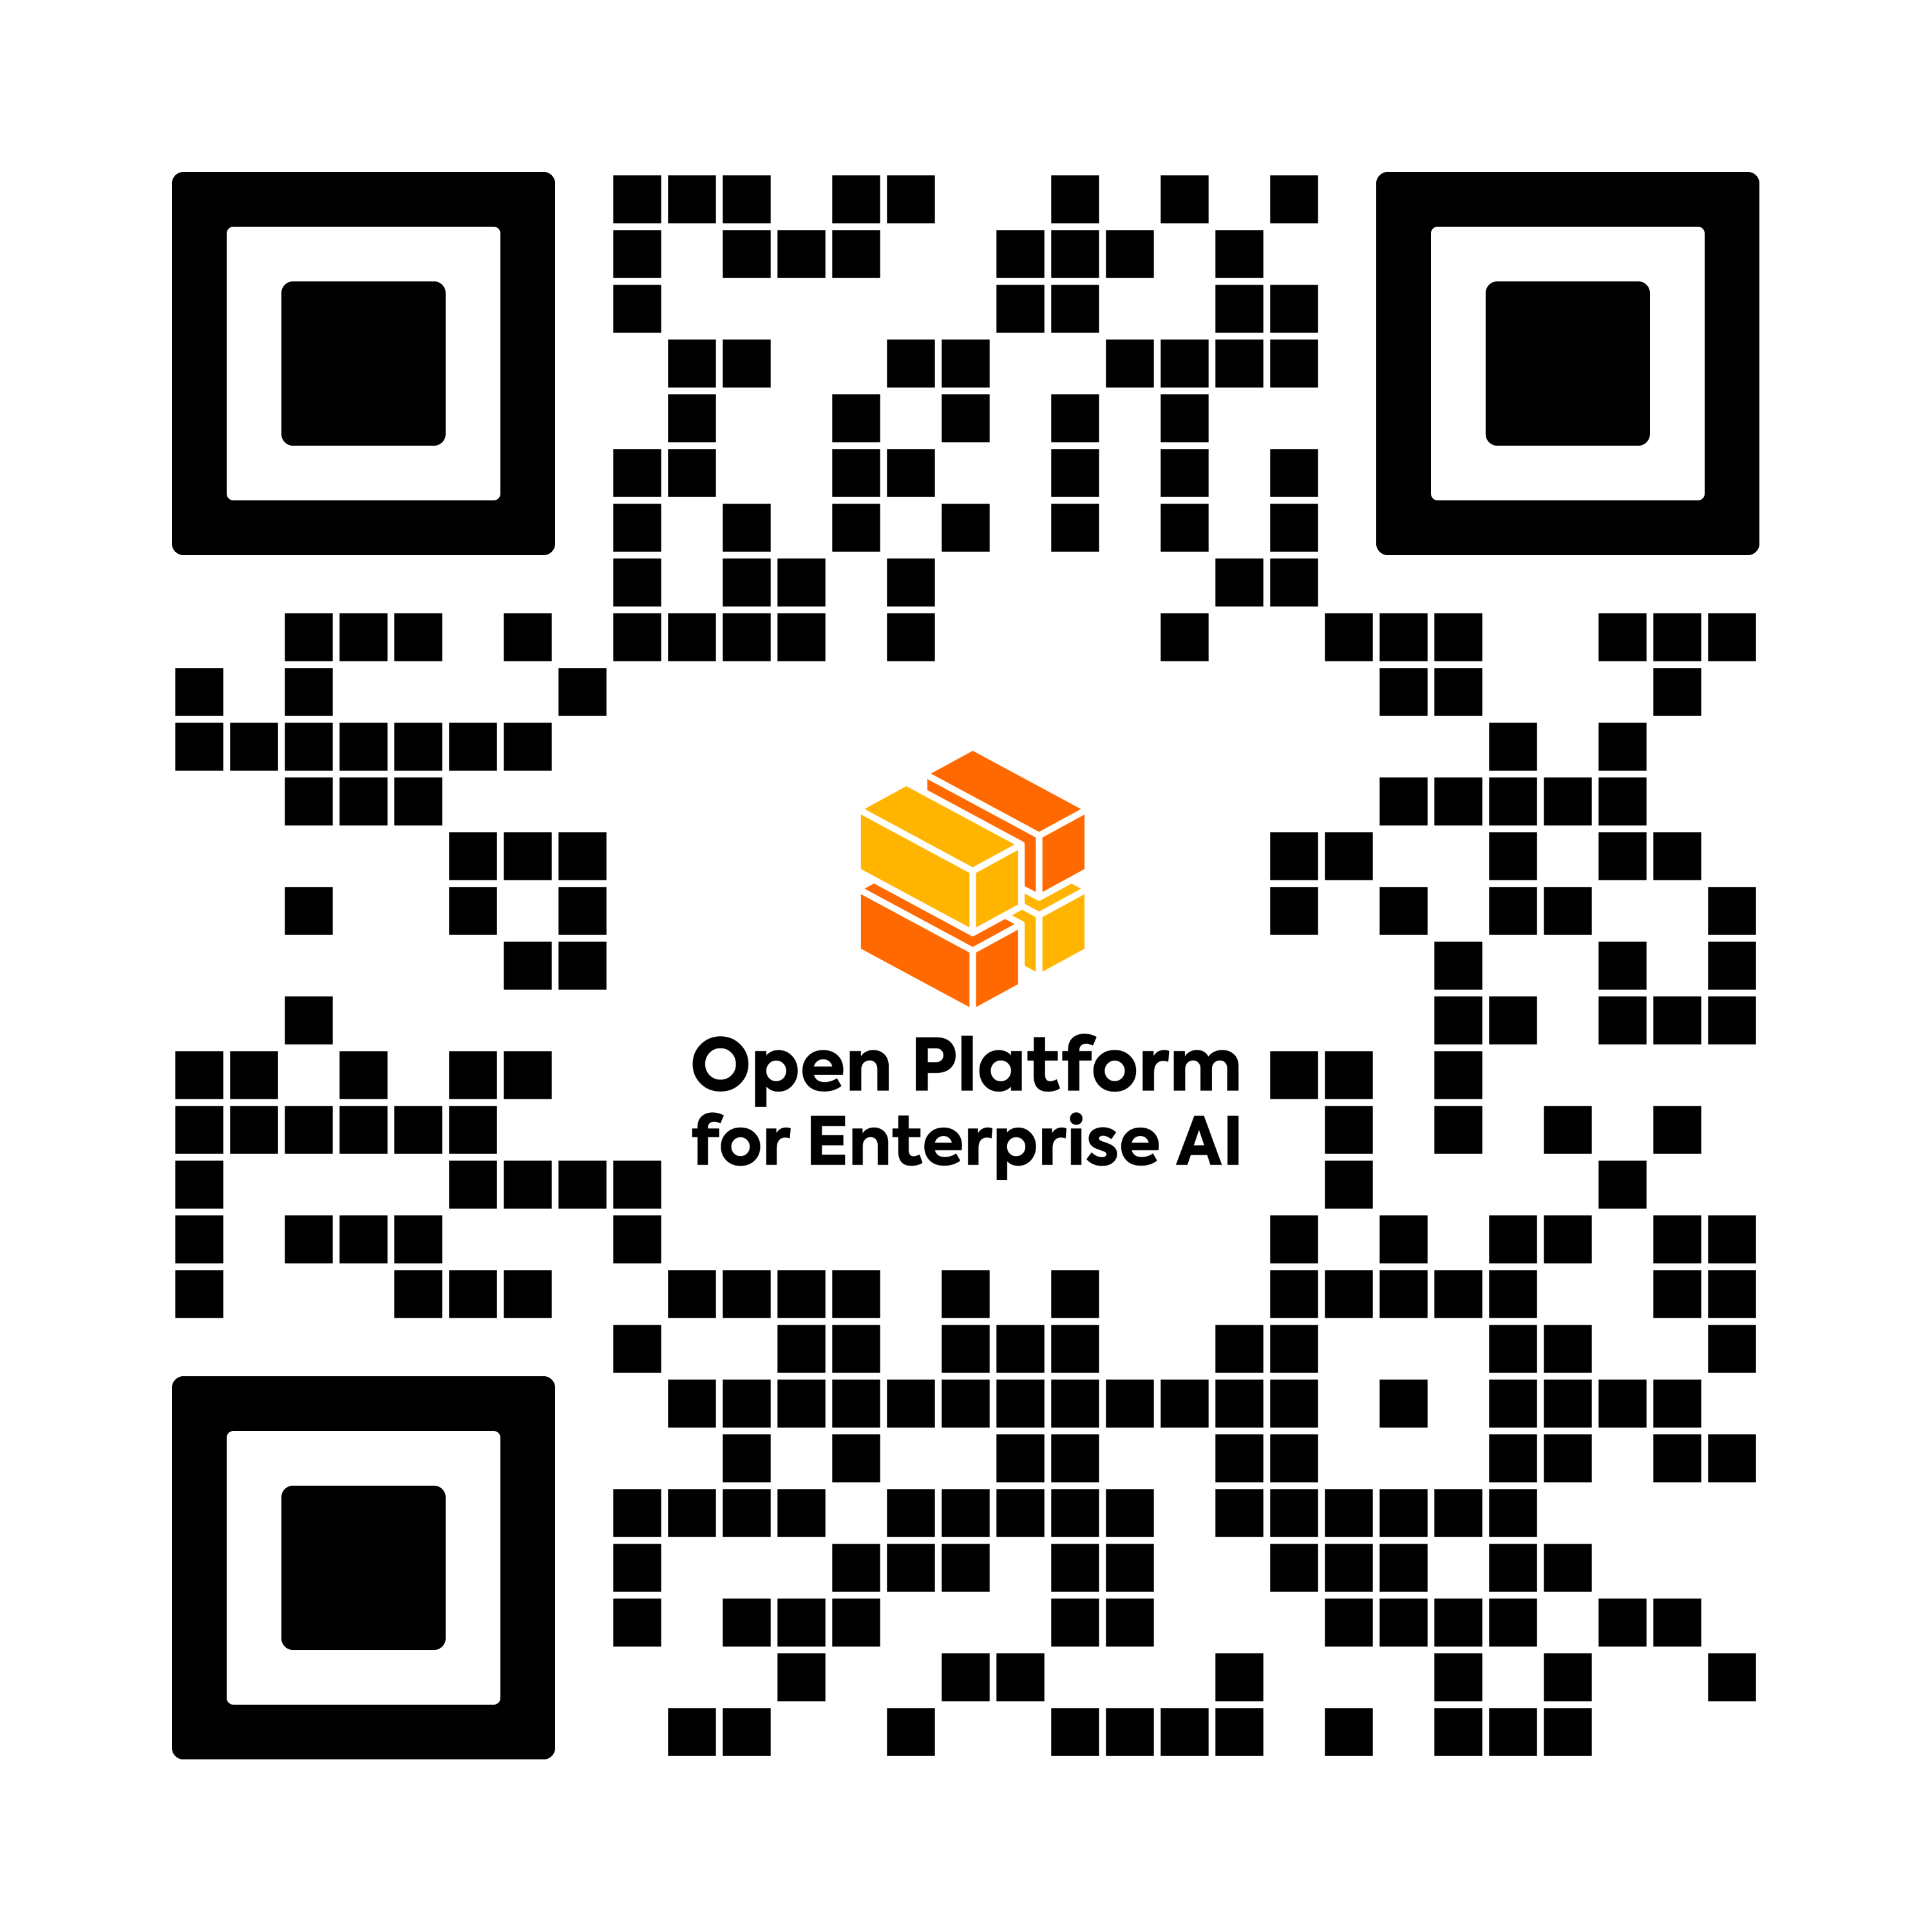

Participate in OPEA
Join a Working Group
Bring Enterprise AI use cases
Contribute code, docs, projects, blueprints, and more
Provide feedback
Evangelism and Promotion of OPEA in YOUR communities, events
Visit OPEA.dev
Notes:
Just OPEA.dev. You can get everywhere else from there.

Slide 9

Download Slides
Notes:
Just OPEA.dev. You can get everywhere else from there.

